Slide 1
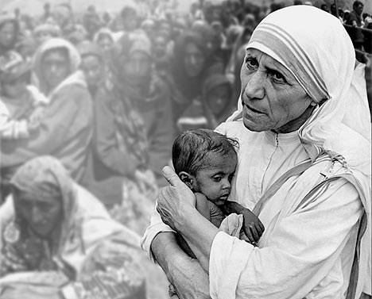
Mother Teresa
Streets of Calcutta

Slide 2
What makes a person a saint?
Notes:
Slide will automatically transition at end of the video. 3.20

Slide 3
Even though Mother Teresa was already a nun she felt a deeper calling to serve Jesus among the poorest of the poor.
It was not easy for her to leave the security of the convent and help the poor. She had no income at first and had to beg for food to eat and share her food with the poor.
We all cannot do what she did but we are also called by God to love and help those around us.

Slide 4
Many women and men wanted to join Mother Teresa and dedicate their lives to helping:
“the hungry, the naked, the homeless, the crippled, the blind, the lepers, all those people who feel unwanted, unloved, uncared for throughout society, people that have become a burden to the society and are shunned by everyone.”
She went on to open many hospice centres for the poor ready to die, homes for sufferers of leprosy, and homes for orphans and homeless youths.
Jesus was in every person she met and so she showed them love. How is her life challenging you to do good deeds?

Slide 5
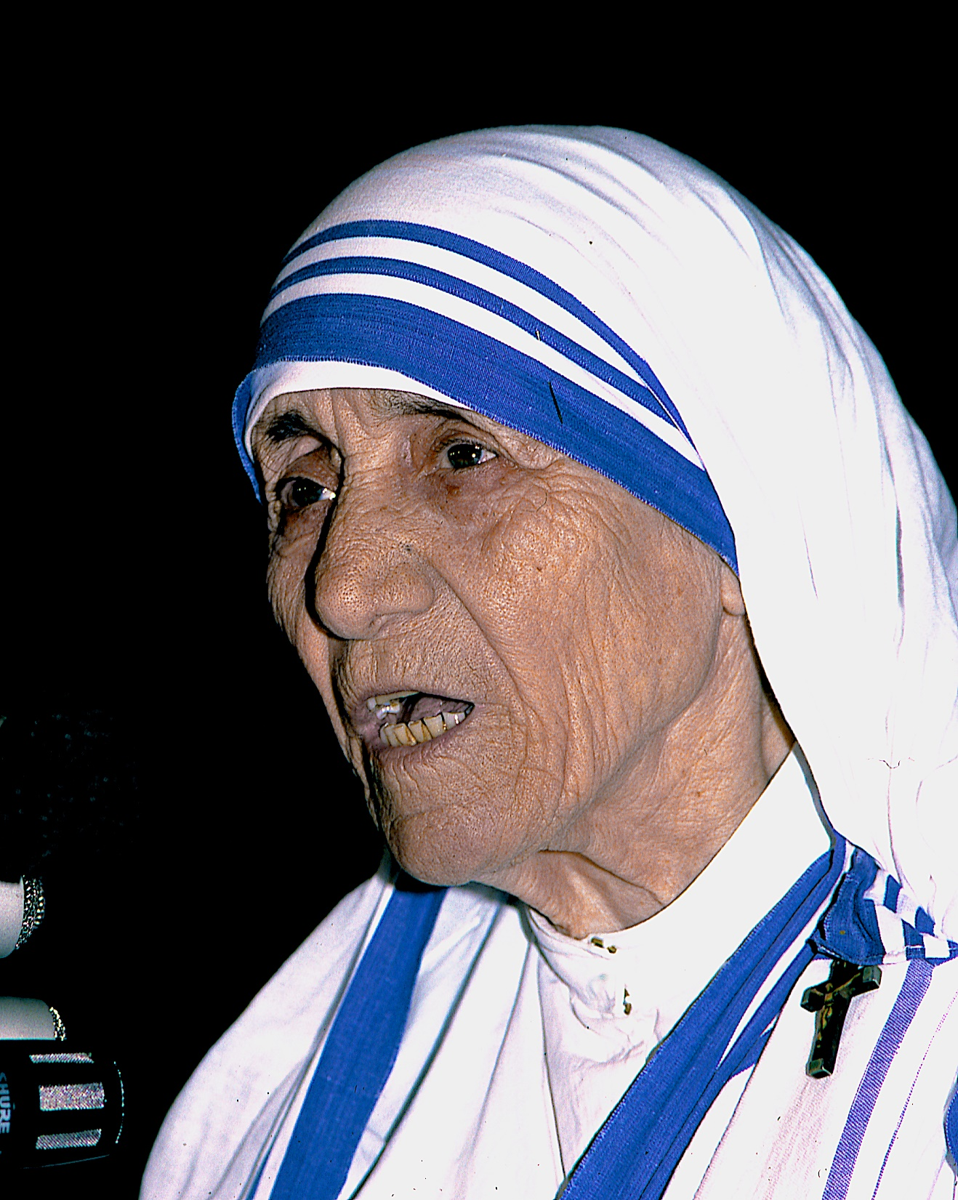
In your Journal answer the following question.
What qualities do you think are needed to become a Missionary of Charity like Mother Teresa?
She was declared a Saint on September the 4th 2016.

Slide 6
Some of Mother Teresa views on working with the poor.
Don’t ever allow anyone, especially your own, to feel lonely, unwanted or unloved.” “We should never allow anyone to go away from us without feeling better and happier. We should be like the reflection of God’s goodness to the poor. We should always have a smile on our lips, a smile for each child we help, for each person who has been abandoned or is sick and to whom we give comfort and medicine. It would matter little if we only offered material gifts, we must offer our heart to all.”
“The poor are great people. They give us much more than we give them. We have learned many things from them. They don’t need our pity. They need our love and compassion.

Slide 7
Some of Mother Teresa views on her relationship with Jesus.
“We all have to see Christ in the poor. The more distasteful the work and the people seem, the greater and stronger should be our faith, our love and our self-giving in the service of our Lord in the poverty we see.
“Intense love does not measure, it just gives.”
“Words which do not give the light of Christ increase the darkness.”
“Many people mistake our work for our vocation. Our vocation is the love of Jesus.”
“Each one of them is Jesus in disguise.”
“Being unwanted, unloved, uncared for, forgotten by everybody, I think that is a much greater hunger, a much greater poverty than the person who has nothing to eat.”

Slide 8
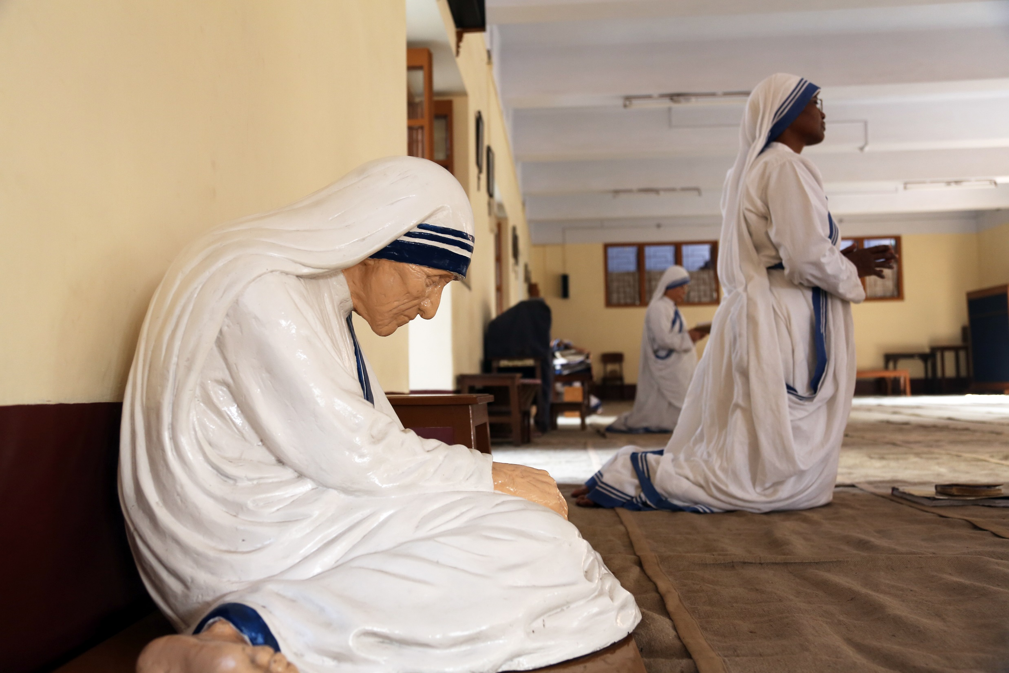
In your Journal answer this question.
How did Mother Teresa view her working with the poor and her relationship with Jesus?

Slide 9
Jesus said many wonderful things, here are some of his sayings or Mottos:
Do not let your hearts be troubled. Trust in God; trust also in me. ...
A new command I give you: Love one another. ...
For what shall it profit a man, if he gain the whole world, and suffer the loss of his soul? ... (So you and your soul is worth more than the whole world)
And know that I am with you always; yes, to the end of time. ...
As the Father has loved me, so have I loved you.
You must love your neighbour as yourself.
Do not be anxious about tomorrow, for tomorrow will be anxious for itself. Let the day's own trouble be sufficient for the day.
Father forgive them, for they know not what they do.
Love your enemies.

Slide 10
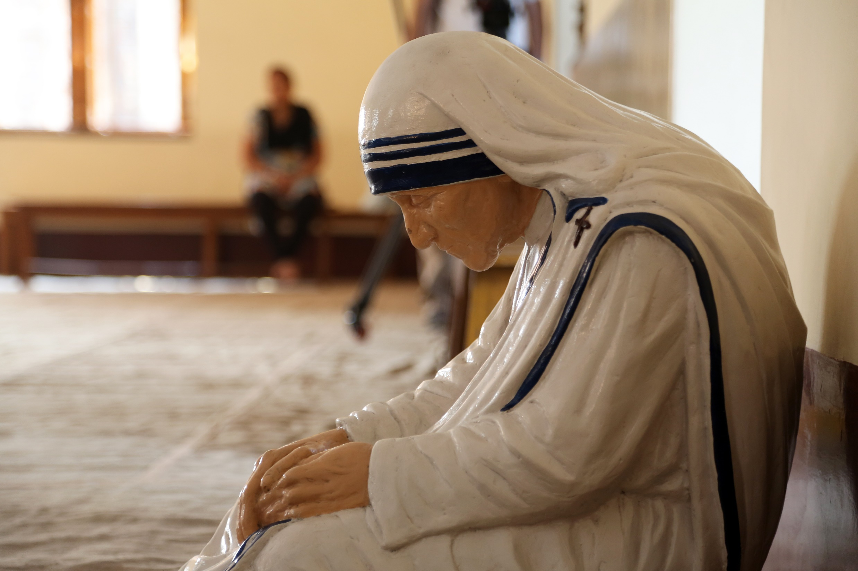
A Gospel Message Motto
Select a motto and describe how this can be applied to your life so that your life is a true reflection of the Gospel.

Slide 11
Come be my light
Notes:
Slide will automatically transition at end of the video. 4.00

Slide 12
Prayer
Let us pray by thinking about these words of St Teresa:
“I am not sure exactly what heaven will be like, but I know that when we die and it comes time for God to judge us, he will NOT ask,
‘How many good things have you done in your life?’ Rather he will ask, How much LOVE did you put into what you did?”

Slide 13
Let us take a moment and think of the things we have done today.
Did we do the things we were asked with joy and enthusiasm?
When we greeted people, did we smile and welcome them with open hearts?
Have we lovingly gone out of our way to help someone?
Take some time to think about the love we have shared with others today…
And together, pray “Glory be to the Father…”

Slide 14
References
Saint Mother Teresa of Kolkata
https://www.youtube.com/watch?v=TvH-OeKEYp4
Come be my light. Liturgically Sound. Used with permission under creative commons licence.
Images purchased from shutterstock.com. Used with permission under licence.
Script by Michael Vella
Voice by Vincent Haber

