Slide 1
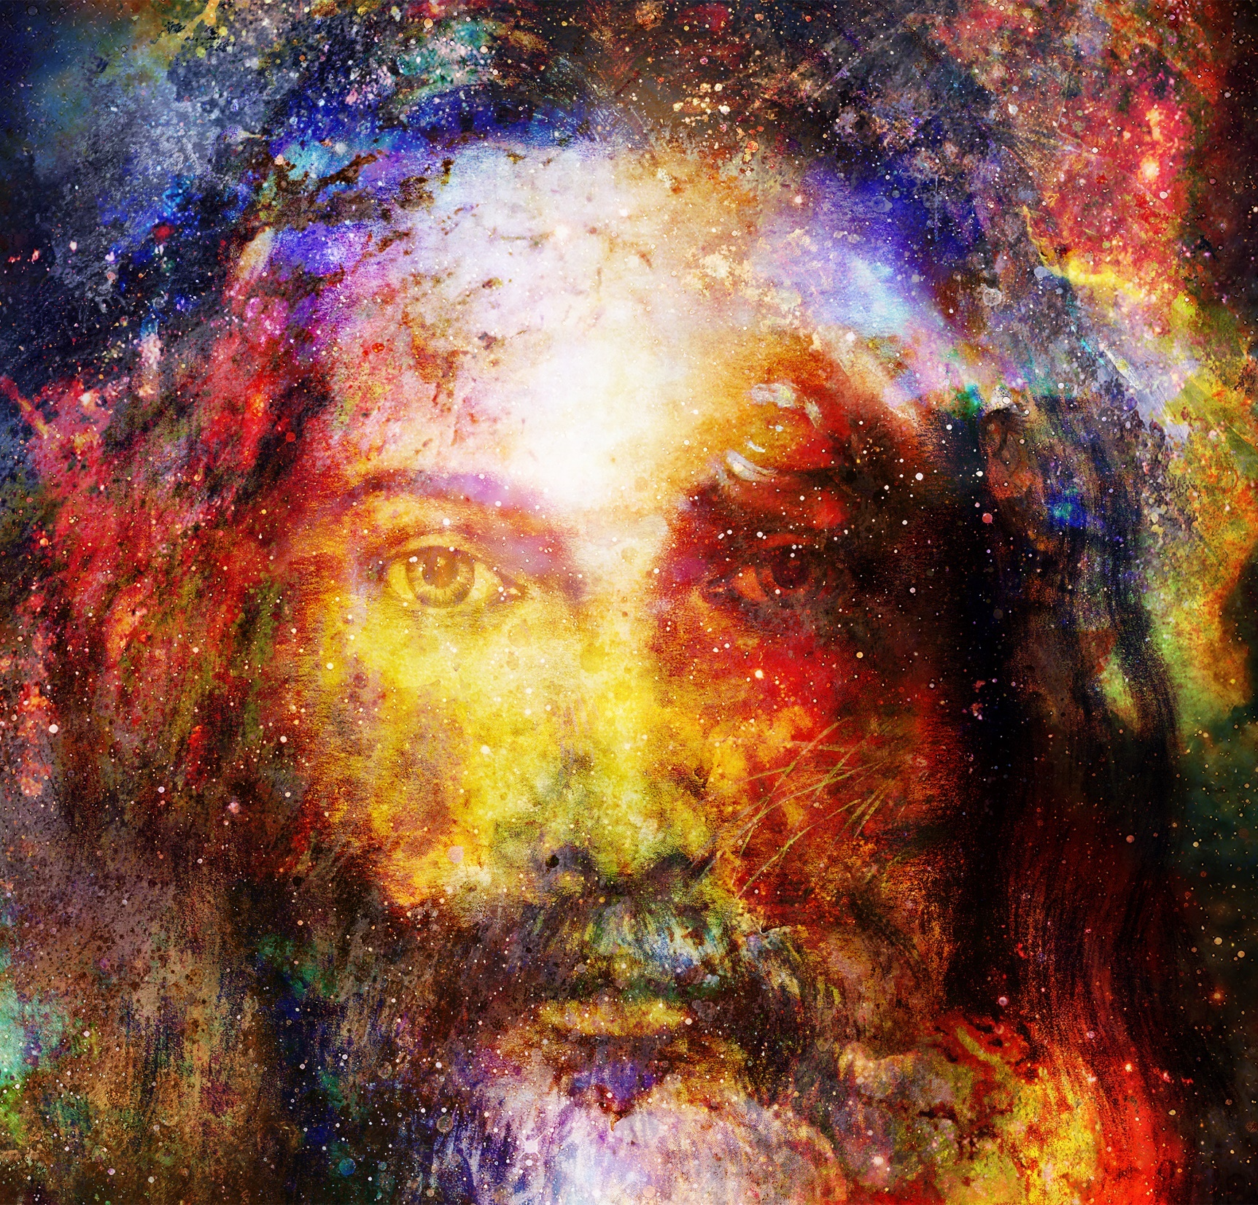
Today’s Disciples

Slide 2
What is a disciple of Jesus?
The term “disciple” originally meant a pupil. Jesus went to Mary, Martha and Lazarus’ house. “As Jesus and his disciples went on their way, he came to a village where a woman named Martha welcomed him in her home. She had a sister named Mary, who sat down at the feet of the Lord and listened to his teaching. Martha was upset over all the work she had to do, so she came and said, “Lord, don't you care that my sister has left me to do all the work by myself? Tell her to come and help me!”
The Lord answered her, “Martha, Martha! You are worried and troubled over so many things, but just one is needed. Mary has chosen the right thing, and it will not be taken away from her.” Luke 10:38-42
So before we can be an active disciple of Jesus we need to enter into a life-long learning process to live the same life as Jesus lived. Jesus always tried to do the will of God.

Slide 3
What is the will of God for you?
On the last day Jesus will call us and we will be judged on how we treat others and Jesus! Let us read the following story Jesus told:
‘Then the King will say to the people on his right, ‘Come, you that are blessed by my Father! Come and possess the kingdom which has been prepared for you ever since the creation of the world. I was hungry and you fed me, thirsty and you gave me a drink; I was a stranger and you received me in your homes, naked and you clothed me; I was sick and you took care of me, in prison and you visited me.’ The righteous will then answer him, ‘When, Lord, did we ever see you hungry and feed you, or thirsty and give you a drink? When did we ever see you a stranger and welcome you in our homes, or naked and clothe you? When did we ever see you sick or in prison, and visit you?’ The King will reply, ‘I tell you, whenever you did this for one of the least important of these followers of mine, you did it for me!’ Matthew 25:34-40

Slide 4
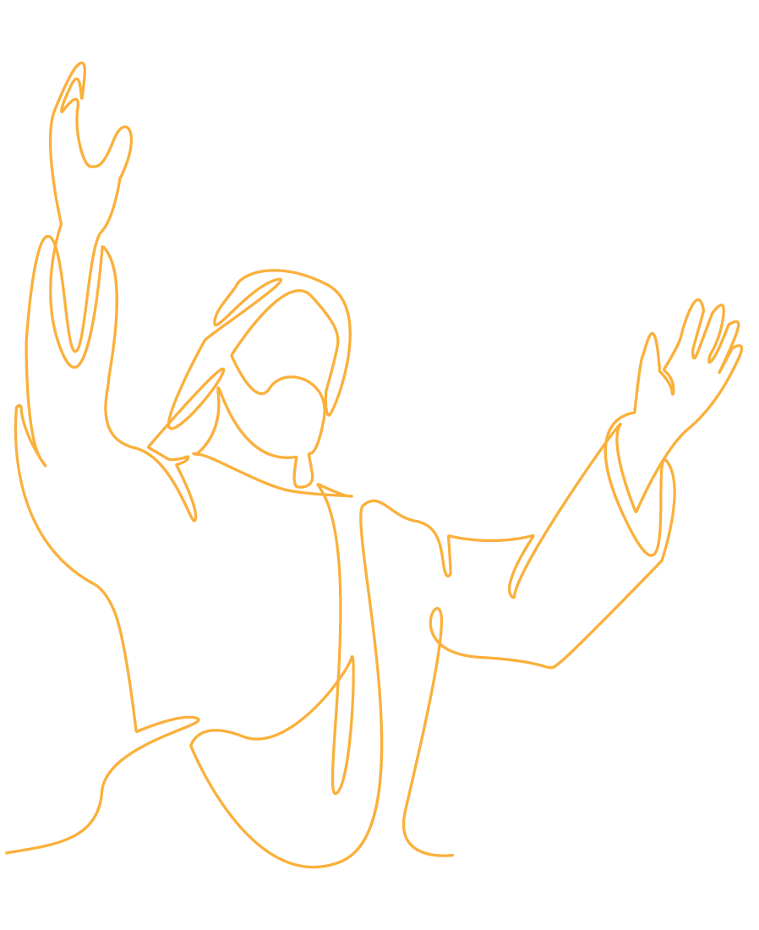
Who is Living a Good Life?
Think: Where can we find Jesus in the story we have just read? Try and remember someone in your life who recognised the beauty and talent hidden within you and built on them to make you feel accepted and worthwhile.
Write in your Journal: What that person did or said to make you feel respected and loved.
A CALL TO ACTION: Jesus was in that person who is also challenging you to be a loving person. How is their action challenging you to do good deeds?

Slide 6
OrangeSky Origin Story Nick Marchesi and Lucas Patchett
Notes:
Slide will automatically transition at end of the video. 1.40

Slide 7
orangesky.org.au - Statistics from August 2019

Slide 8
Think and write in your journal possible answers for the following questions:
What advantages do you think these two men had growing up?
Who do you think influenced their lives to care for those in need?
Apart from washing the people’s clothes, how else do the men and their volunteers minister to those people who are homeless? What do you think is more effective?

Slide 9
Prayer

Slide 10
REFLECTION MUSIC

Slide 11
‘Never see a need without doing something about it’

Slide 12
What needs are there in your school that you could do something about?
If Jesus started off these statements on the Last Day, how would finish them off?
When I felt alone and isolated at school you ………..
When I was crying and upset you ………..
When people were racist towards me you ………..
When I had no lunch and felt hungry you ………..
When I was useless at sport or games but still wanted to play you ………..
When others made fun of the way I look or dress you ….

Slide 13
God is here (Emmanuel Worship)
Notes:
Slide will automatically transition at end of the video. 4.11

Slide 14
References
Orange Sky Origins – new video with direct download provided; permission received from Megan Groundwater, Orange Sky Communications Officer (4 June 2019)
Nick Marchesi and Lucas Patchett
Here is a similar video about how Orange Sky kicked off and the service we provide.
https://www.dropbox.com/s/dqlf4s1zli50jp9/Cisco_Origins_Trimmed.mp4?dl=0
The only requirement from us is that you use the video in full (including our logo at the end) and it is not repurposed.
Music Video: God is here (EmmanuelWorship – used with permission under licence)
Background images: danstevers.com and shutterstock.com (purchased); Creative Commons: unsplash.com
Script by Michael Vella
Voice by Vincent Haber

